Slide 1
Web development project
Session 2016-17

Slide 2
Group 1 members
Lakshmendra Singh (15-dpce-166)
Akshay dubey (15-dpce-171)
Naveen sarswat (15-dpce-173)
Hritick goyal (15-dpce-183)

Slide 3
About the website
This website is based on cars, statistics and data related to various cars and also about specifications of cars.
In this websites we’ve included various cars of different features and categories.
A detailed information about each car including interior views, information about engine, transmission and pricing has been included.
The information has been displayed in a catchy and attractive manner in this website.

Slide 4
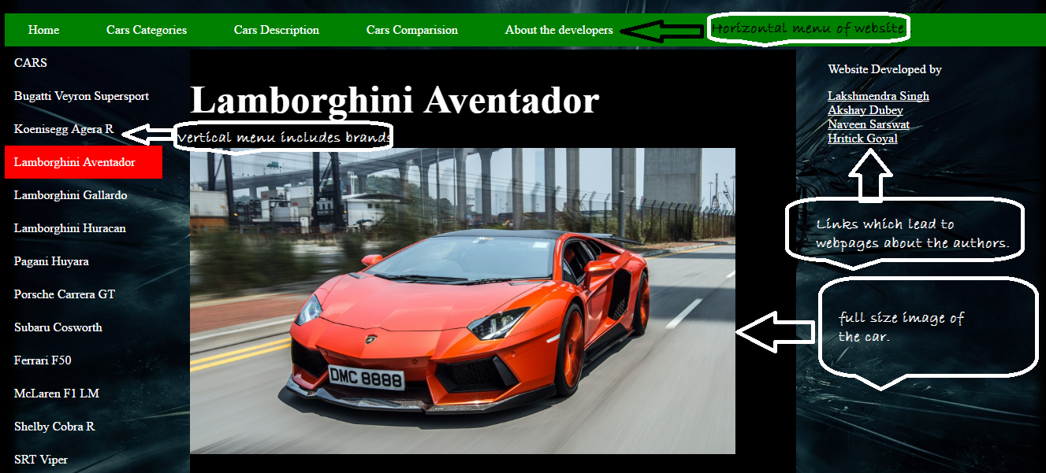
Description page

Slide 5
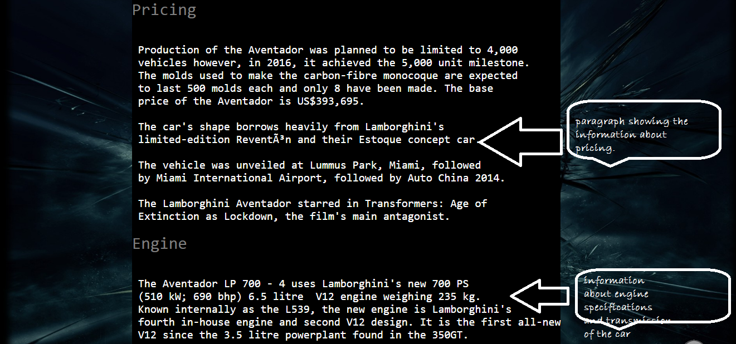
Description page

Slide 6
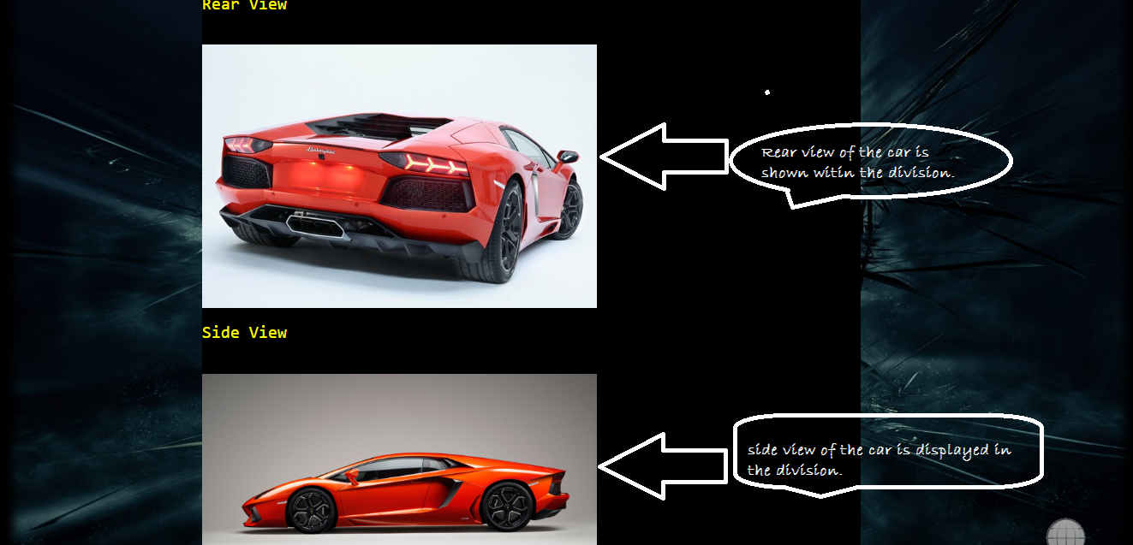
Description page

Slide 7
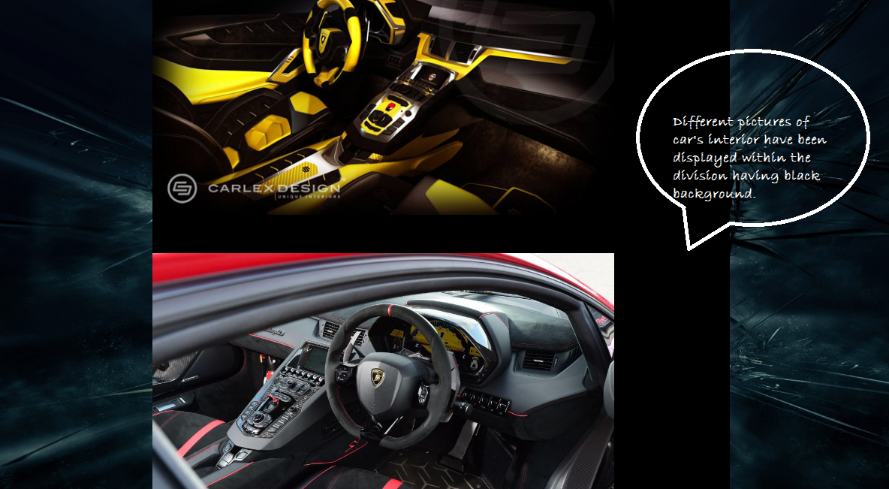
Description page

Slide 8
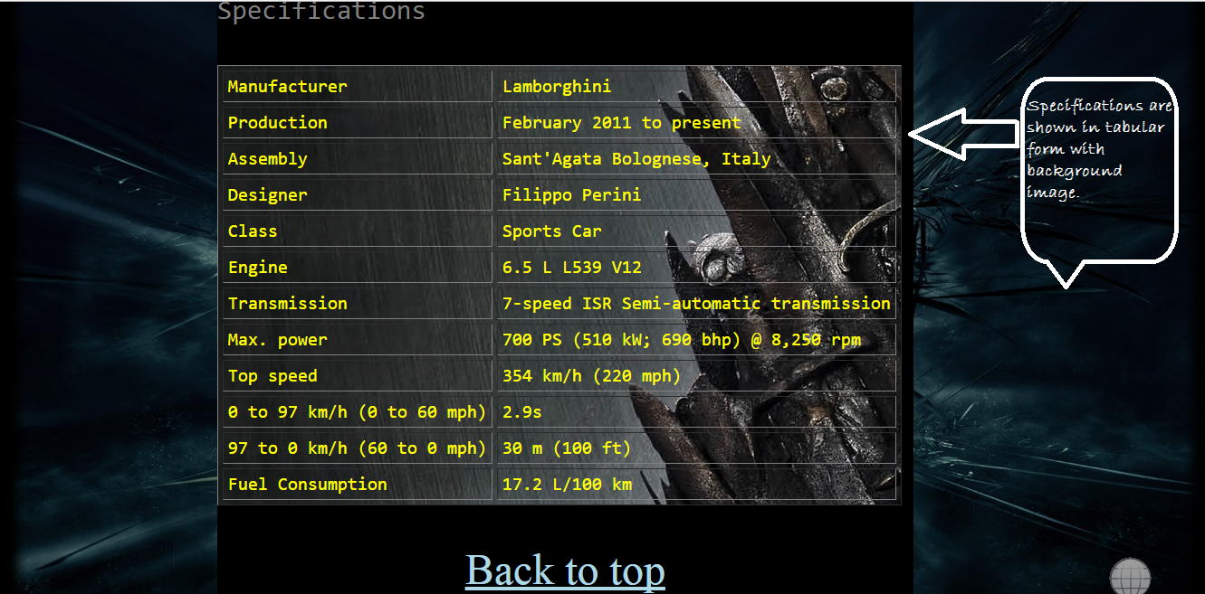
Description page

Slide 9
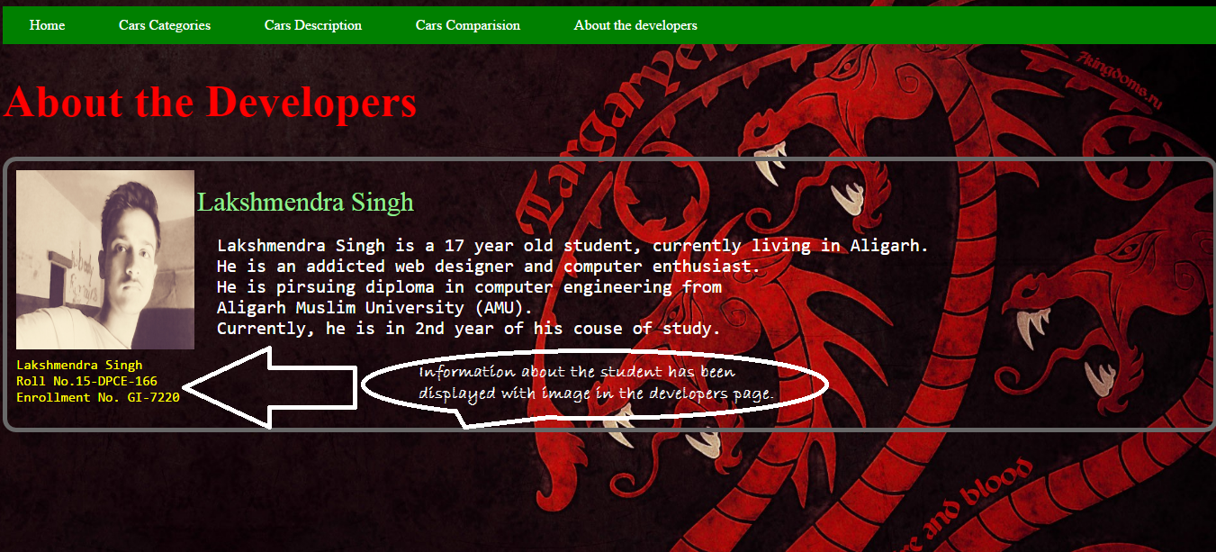
About the developers page

Slide 10
Thank you

